Slide 1
A generic framework for privacy preserving deep learning——Pysyft
arXiv:1811.04017v2 [cs.LG] 13 Nov 2018
张文博 2022.02.25

Slide 2
Abstract
The authors detail a new framework for privacy preserving deep learning.
The framework puts a premium on ownership and secure processing of data.
The authors introduces a valuable representation based on chains of commands and tensors.
The authors believe this work is an important milestone introducing the first reliable, general framework for privacy preserving deep learning.

Slide 3
Introduction
The main contributions are the following:
They first build a standardized protocol to communicate between workers which made federated learning possible.
Then, we develop a chain abstraction model on tensors to efficiently override operations (or encode new ones) such as sending/sharing a tensor between workers.
Last, we provide the elements to implement recently proposed differential privacy and multiparty computation protocols using this new framework.

Slide 4
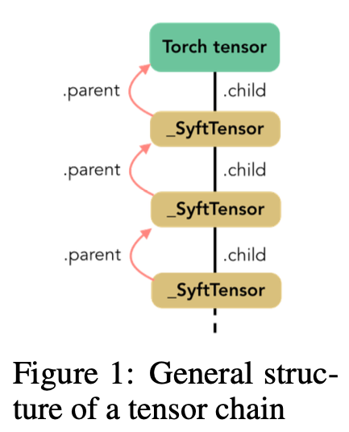
The chain structure
Performing transformations or sending tensors to other workers can be represented as a chain of operations.
Each operation is embodied by a special class.
Transformations or states can be accessed through child or parent attributes.

Slide 5
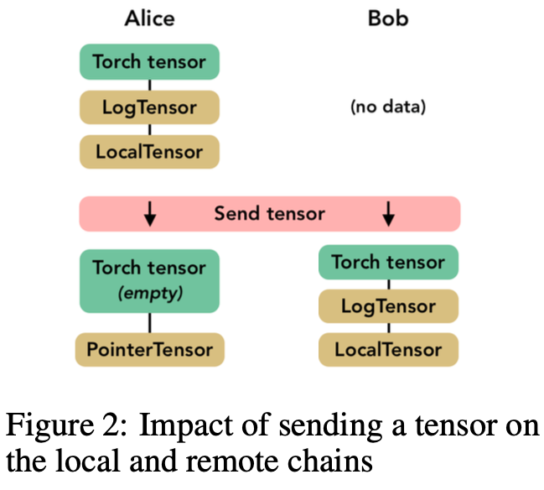
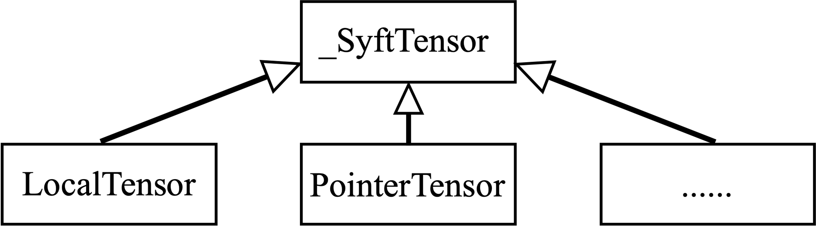
_SyftTensor
LocalTensor
PointerTensor
......
The chain structure
The LocalTensor which is created automatically when the Torch tensor is instantiated.
Its role is to perform on the Torch tensor the native operation corres-ponding to the overloaded operation.
The PointerTensor which is created when a tensor is sent to a remote worker.
Sending and getting back a tensor is as simple as calling the methods send(worker) and get() on the tensor.

Slide 6
From virtual to real context execution
Virtual context: Implemented by Virtual Workers
In order to simplify debugging complex chains of operations.
They live on the same machine and don’t communicate over the network.
They simply replicate the chain of commands and expose the very same interface as the actual workers to communicate with each other.
Real context: Implemented by plain network sockets or Web Sockets
Web Socket workers allow multiple workers to be instantiated from within a browser, each within its own tab.
This gives us another level of granularity before actually addressing remote workers not on the same machine.

Slide 7
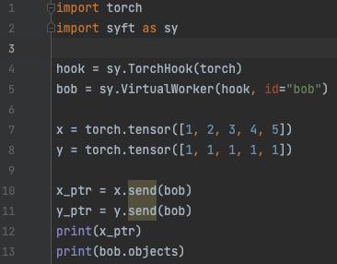
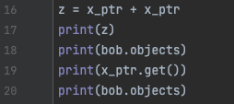
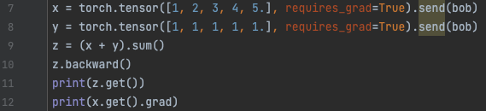

Example
1
3
4
1
2
2

Slide 8
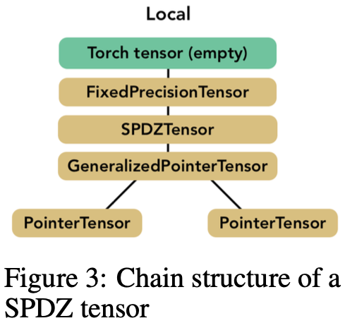
Towards a Secure MPC framework
MPC toolbox proposed in framework implements the SPDZ protocol.
The MPC toolbox includes basic operations such as addition and multiplication but also preprocessing tools to generate for instance triples used for multiplication, and more specific operations to neural networks including matrix multiplication.

Slide 9
Applying Differential Privacy
The authors implemented differential privacy based on the work of 《Deep learning with differential privacy》
Including： Differentially Private SGD Algorithm、Lots、 Moments Accountant、Sanitizer ...

Slide 10
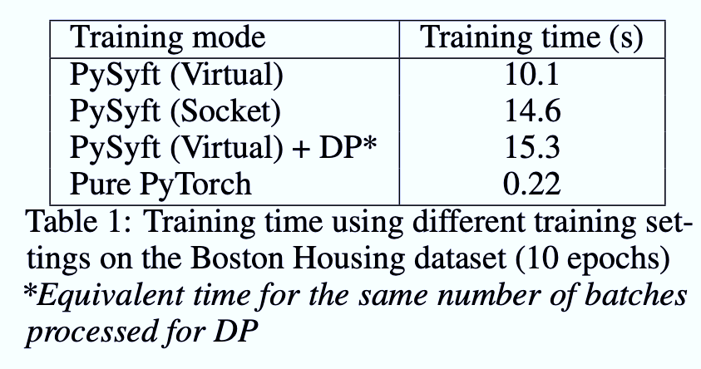
Experiment and Results
Boston Housing Dataset
（Contains 506 pieces of data, including 13 features）
Use a simple neural network
A performance analysis denotes a reasonably small overhead for using Web Socket workers instead of Virtual Workers.
The framework is however 46 times slower than using regular PyTorch.

Slide 11
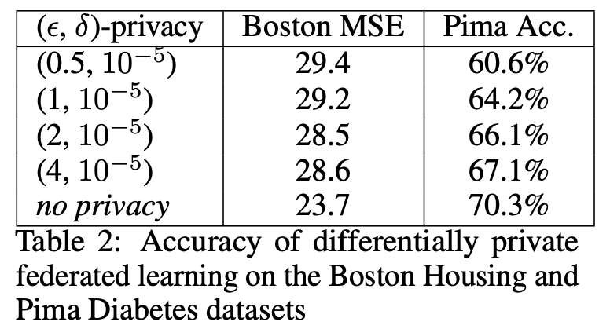
Experiment and Results
Pima Indian Diabetes
（Contains 768 pieces of data, including 8 features）
Use a simple neural network
The overall trend is that when the privacy budget is large, the loss function is small and the accuracy rate is high.
The baseline model spends approximately 19.8ms per batch while the differentially private model spends about 30.0ms, which is a very reasonable overhead (+50%) for a feature like privacy.

Slide 12
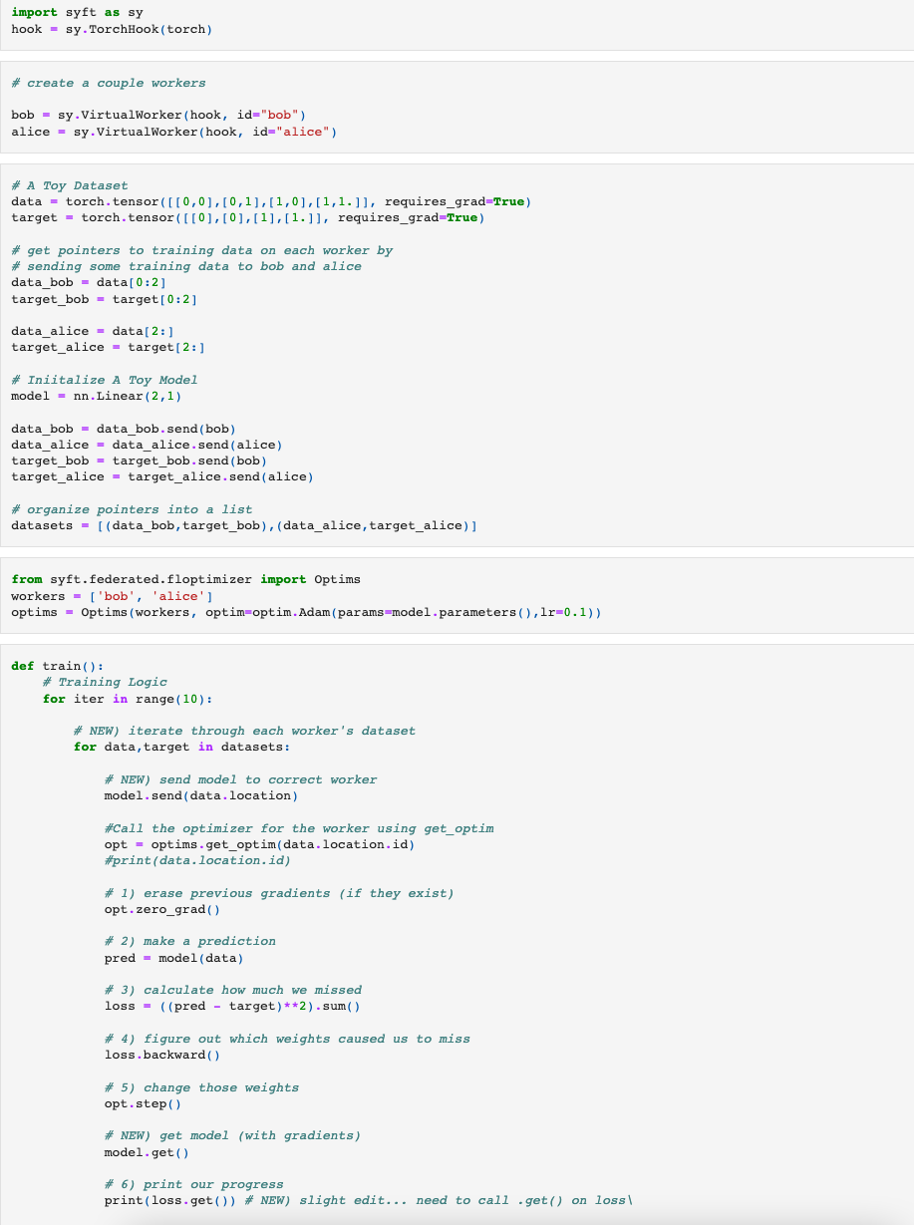
Example
1
2

Slide 13
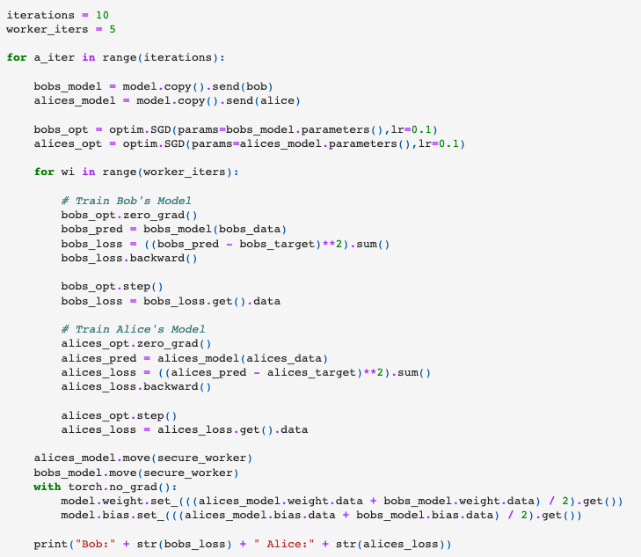
Example

Slide 14
Example
Tutorial: Federated Learning on MNIST using a CNN
https://github.com/OpenMined/PySyft/blob/v0.2.4/examples/tutorials/Part%2006%20-%20Federated%20Learning%20on%20MNIST%20using%20a%20CNN.ipynb

Slide 15
Thank You For Listening！
张文博 2022.02.25

